Slide 1
Advanced Data Centric Web Applications
Bachelor of Science (Honours) in Computing in Software Development
Bachelor of Science in Computing in Software
Development
Department of Computer Science & Applied Physics

Slide 2
Maven
"Apache Maven is a software project management and comprehension tool. Based on the concept of a Project Object Model (POM), Maven can manage a project's build, reporting and documentation from a central piece of information.”

Slide 3
Maven - Features
A project management tool, with a project object model.
Follows a set of standards.
Includes a project build lifecycle:
Prepare-resources
Compile
Package
Install
Has a dependency management system.

Slide 4
Maven - Features
Projects follow a consistent structure.
Projects are IDE agnostic.
Projects are easily modified.
Maven simplifies the declaration of project properties.

Slide 5
Maven - Features
Projects have default behaviours.
Source code is always in the src/main folder.
Test cases are always in the src/test folder.
Resources necessary for the project are in a specific folder.
The final JAR file is always in the target folder.

Slide 6
XML
XML stands for eXtensible Markup Language.
Designed to store and transport data.
Designed to be both human- and machine-readable.
Designed to be self-descriptive.
XML separates data from presentation.
XML does not, by itself, do anything.

Slide 7
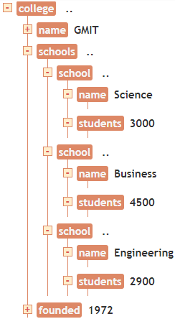
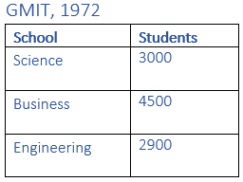
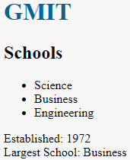
XML Example
<?xml version="1.0" encoding="UTF-8"?>
<college>
<name>GMIT</name>
<schools>
<school>
<name>Science</name>
<students>3000</students>
</school>
<school>
<name>Business</name>
<students>4500</students>
</school>
<school>
<name>Engineering</name>
<students>2900</students>
</school>
</schools>
<founded>1972</founded>
</college>

Slide 8
XML – More Features
XML has no predefined tags.
XML is extensible.

Slide 9
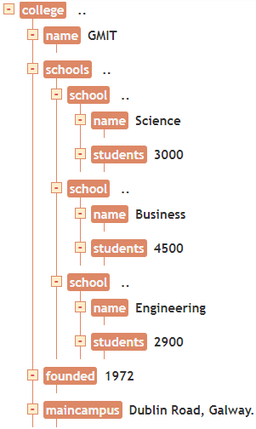
XML Example
<?xml version="1.0" encoding="UTF-8"?>
<college>
<name>GMIT</name>
<schools>
<school>
<name>Science</name>
<students>3000</students>
</school>
<school>
<name>Business</name>
<students>4500</students>
</school>
<school>
<name>Engineering</name>
<students>2900</students>
</school>
</schools>
<founded>1972</founded>
<mainCampus>Dublin Road, Galway.</mainCampus>
</college>

Slide 10
XML Namespaces
A namespace is a set of names in which all names are unique.
Namespaces make it easier to come up with unique names.
As element names are user-defined, there could be conflicts when trying to use XML documents from different sources.
XML Namespaces provide a method to avoid element name conflicts.
The namespace URI is not used by the parser to look up information.
The purpose of using an URI is to give the namespace a unique name.
However, companies often use the namespace as a pointer to a web page containing namespace information.

Slide 11
XML with Namespaces
<root
xmlns:st="http://namespace1/"
xmlns:sc="http://namespace2/">
<st:sid>
<st:sname>John</st:sname>
<st:course>SW</st:course>
</st:sid>
<sc:sid >
<sc:sname>St. Johns NS</sc:sname>
<sc:students>300</sc:students>
</sc:sid>
</root>

Slide 12
Maven - POM
The POM stands for "Project Object Model". It is an XML representation of a Maven project held in a file named pom.xml.
In Maven a project is more than a collection of files containing code.

Slide 13
Maven - POM
The Project Model includes:
A project description
A unique set of coordinates
Project attributes
License information
Project version
Authors or contributors to the project
A list of project dependencies.

Slide 14
Maven - POM
<project xmlns=http://maven.apache.org/POM/4.0.0
xmlns:xsi=http://www.w3.org/2001/XMLSchema-instance
xsi:schemaLocation="http://maven.apache.org/POM/4.0.0 http://maven.apache.org/xsd/maven-4.0.0.xsd">
<modelVersion>4.0.0</modelVersion>
<groupId>com.mycompany.app</groupId>
<artifactId>my-app</artifactId>
<version>1.0</version>
</project>
The above is the minimum requirements for a POM.
The groupId, artifactId and version compose the Maven Coordinates.

Slide 15
Maven – Dependency Management
Allows for code reuse.
Dependencies are defined in the pom.xml file using the Maven coordinates.

Slide 16
Maven – Dependency Management
<dependencies>
<dependency>
<groupId>org.springframework</groupId>
<artifactId>spring-core</artifactId>
<version>4.3.4.RELEASE</version>
</dependency>
<dependency>
<groupId>org.springframework</groupId>
<artifactId>spring-context</artifactId>
<version>4.3.4.RELEASE</version>
</dependency>
</dependencies>
The Maven coordinates make the dependencies unique.

Slide 17
Maven - Repositories
In Maven, a repository is a place i.e. directory where all the project jars, library jars, plugins or any other project specific artifacts are stored and can be used by Maven easily.
There are three types of Maven repository:
local
central
remote

Slide 18
Maven - Repositories
The dependency search process is as follows:
Search for the dependency in the local repository.
If the dependency is found the search is complete, otherwise go to step 2.
Search for the dependency in Maven Central Repository.
If the dependency is found it is downloaded to the local repository. Otherwise go to step 3.
Check if there is a remote repository mentioned.
If not throw an error. Otherwise go to step 4.
Search for the dependency in the remote repository.
If the dependency is found it is downloaded to the local repository. Otherwise throw an error.

Slide 19
Dependency Injection
Dependency Injection is an implementation of the Dependency Inversion Principle.
The Dependency Inversion Principle states:
“High-level modules should not depend on low-level modules. Both should depend on abstractions.
Abstractions should not depend on details. Details should depend on abstractions”.

Slide 20
Dependency Injection
A Dependency is an object that a class needs to function.
Injecting a dependency into a class means that the dependency is “pushed” into the class from outside.
The dependency is not instantiated inside the class.
Decouples a classes construction from the construction of its dependencies.
In Spring, spring-core, spring-beans and spring-context are the modules responsible for Dependency Injection.

Slide 21
Spring Dependency Injection
App
public class App {
public static void main(String[] args) {
Person person = new Person();
person.sayHello();
}
}
Person
package com.lab1;
public class Person {
public void sayHello() {
System.out.println("Hello from Person");
}
}

Slide 22
Spring Dependency Injection
App
public class App {
public static void main(String[] args) {
ApplicationContext context =
new ClassPathXmlApplicationContext ("beans.xml");
Person person = (Person) context.getBean("personBean");
person.sayHello();
}
}
beans.xml
<bean id="personBean" class="com.lab1.Person"></bean>
Person
package com.lab1;
public class Person {
public void sayHello() {
System.out.println("Hello from Person");
}
}

Slide 23
Spring Dependency Injection
What if Person had the following properties:
Name
Age
Address
And Address was in turn an object with the following properties:
Street
Town
County
The object creating the Person object would have to also know about the Address object on which Person is dependent.
With DI we can simply inject the details into the outer object, without it having to know the implementation details.

